Slide 1
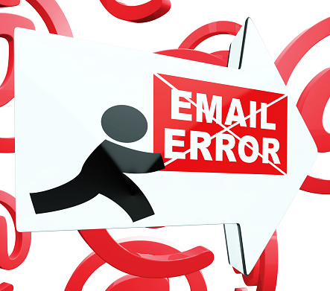
COMMON EMAIL WRITING ERROR

Slide 2


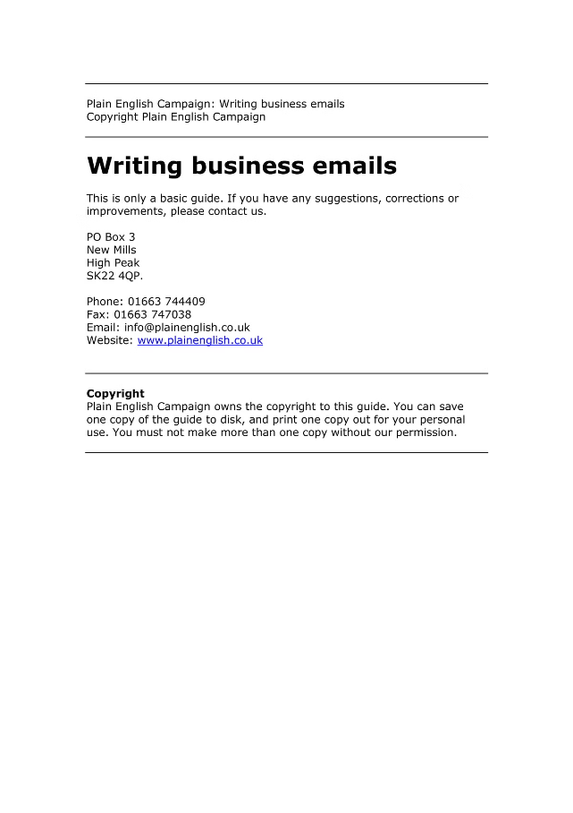
INTRODUCTION
Email is a powerful tool for communication. It's essential to write emails effectively to ensure your message is clear and well-received. Avoid common writing errors to enhance your professionalism.

Slide 3

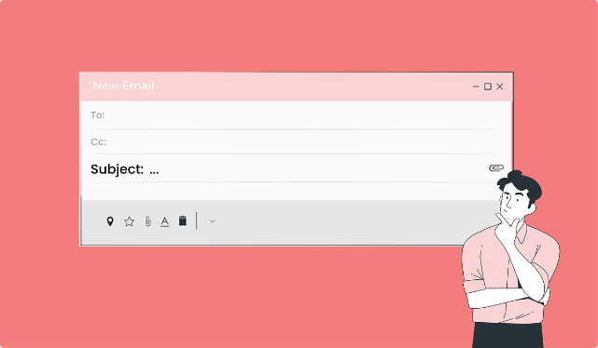
Lack of Clear Subject Lines
1
Clarity
2
Importance
Subject lines should be concise and specific, providing a clear indication of the email's purpose. Avoid generic or vague subject lines.
A clear subject line helps the recipient quickly understand the email's content and prioritize their response.
3
Professionalism
A well-written subject line reflects professionalism and attention to detail, making a positive impression on the recipient.

Slide 4
Improper Email Formatting
Paragraphs
Font
Spacing
Use clear paragraph breaks to separate ideas and make the email easier to read. Avoid large blocks of text.
Choose a standard font like Arial or Times New Roman, and maintain a consistent font size throughout the email.
Use appropriate line spacing to make the text easy on the eyes. Avoid excessive spacing or cramped text.

Slide 5





Spelling and Grammar Mistakes
Proofreading
Always proofread your emails carefully before sending them. Look for spelling, grammar, and punctuation errors.
Spell Checkers
Utilize spell checkers and grammar checkers to catch common errors.
Clarity
Correcting errors ensures that your message is clear and professional, preventing misunderstandings.

Slide 6
Which of the following sentences contains a common grammatical error?
a)"I look forward to hearing from you." b) "Please let me know if you have any questions." c) "Your welcome to join the meeting." d) "Attached is the document you requested.“

Slide 7
5. Which of the following sentences contains a common grammatical error?
a)"I look forward to hearing from you." b) "Please let me know if you have any questions." c) "Your welcome to join the meeting." d) "Attached is the document you requested.“
Answer: c) "Your welcome to join the meeting."

Slide 8

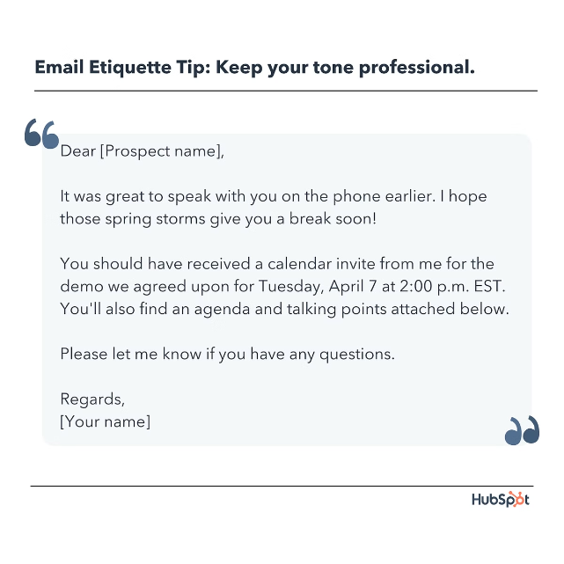
Inappropriate Tone and Language
Formal
Use formal language and avoid slang or informal expressions.
Informal
Use a friendly but professional tone, considering your relationship with the recipient.
Always be respectful and avoid offensive or discriminatory language.
Respectful

Slide 9

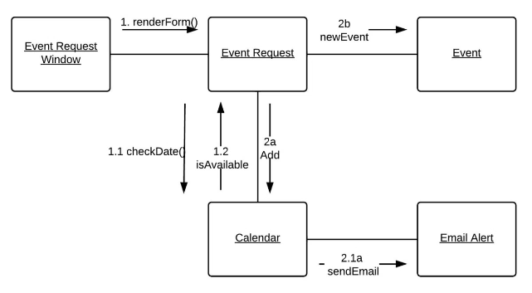
Unclear or Incomplete Message
Clarity
Details
State your purpose clearly and concisely. Make sure your message is easy to understand.
Provide sufficient information to avoid any confusion or need for follow-up questions.
Actionable
If you are requesting something, make it clear what action you expect from the recipient.

Slide 10
What error is present in the following email phrase: "I hope your doing well"?
a) Incorrect word choice b) Punctuation error c) Spelling mistake d) Incorrect use of homophones

Slide 11
What error is present in the following email phrase: "I hope your doing well"?
a)Incorrect word choice b) Punctuation error c) Spelling mistake d) Incorrect use of homophones
Answer: d) Incorrect use of homophones

Slide 12

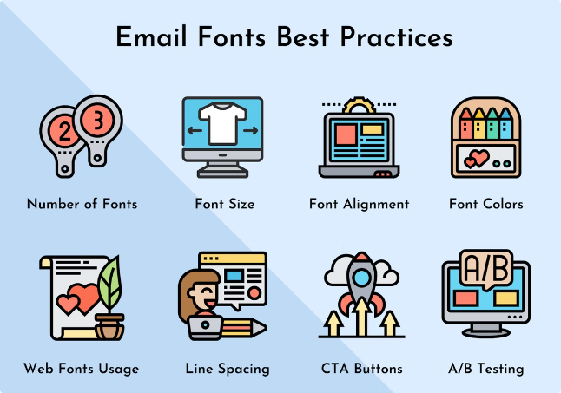
Failure to Proofread Before Sending
1
Read Aloud
Read your email out loud to catch errors you might miss when reading silently.
2
Fresh Eyes
Have someone else proofread your email for an unbiased perspective.
3
Double Check
Review the email thoroughly, especially for any names, dates, or numbers.

Slide 13

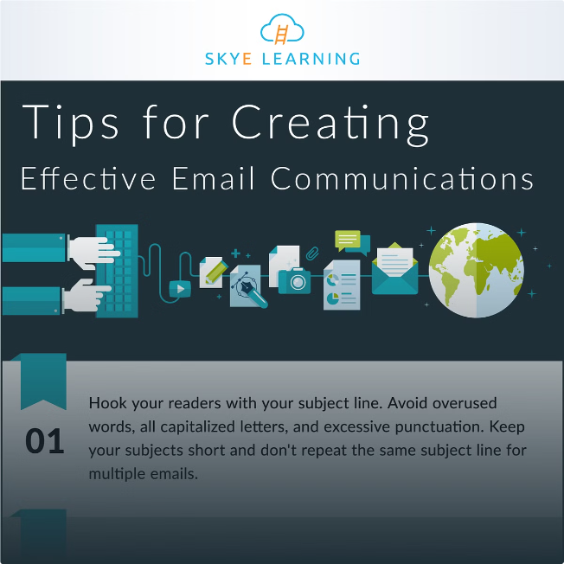




Strategies for Improving Email Communication
Plan
Draft
Take the time to plan your emails, considering the purpose and audience. Outline your message beforehand.
Write a draft of your email, ensuring it's clear, concise, and error-free.
Revise
Send
Review and revise your email for clarity, tone, and overall effectiveness.
Once you are satisfied with the email, send it confidently knowing it represents your professionalism.

Slide 14

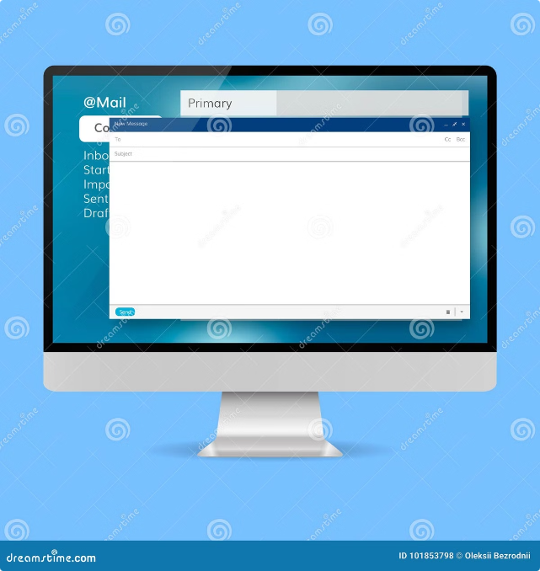
Email Structure
Emails are a fundamental form of digital communication. Understanding email structure is crucial for effective and professional communication.

Slide 15
Subject Line
A subject line is the first thing a recipient sees. It should be concise, clear, and relevant.
Clear
Concise
The subject line should accurately reflect the email's content, preventing confusion for the recipient.
Avoid lengthy subject lines that can be overwhelming. Keep it brief and to the point.
Relevant
Ensure the subject line is directly related to the email's content, enhancing the recipient's understanding.

Slide 16
Which of the following is an example of a poorly written email subject line?
a) "Meeting Schedule for Next Week" b) "FYI" c) "Quarterly Report: Deadline Extended" d) "Invitation to Annual Conference"

Slide 17
Which of the following is an example of a poorly written email subject line?
a)"Meeting Schedule for Next Week" b) "FYI" c) "Quarterly Report: Deadline Extended" d) "Invitation to Annual Conference“
Answer: b) "FYI"

Slide 18



Salutation
The salutation is the greeting at the beginning of the email. It should be appropriate for the recipient.
Formal
Informal
Use "Dear [Recipient's Name]" for professional and formal emails.
For casual emails, you can use "Hi [Recipient's Name]" or simply "Hello."

Slide 19
What is a common mistake in the salutation of a professional email?
a) Using the recipient's first name without permission b) Including a title like "Mr." or "Ms." c) Using "Dear" followed by the recipient's last name d) Using "Hi" as a greeting

Slide 20
What is a common mistake in the salutation of a professional email?
a)Using the recipient's first name without permission b) Including a title like "Mr." or "Ms." c) Using "Dear" followed by the recipient's last name d) Using "Hi" as a greeting
Answer: a) Using the recipient's first name without permission

Slide 21

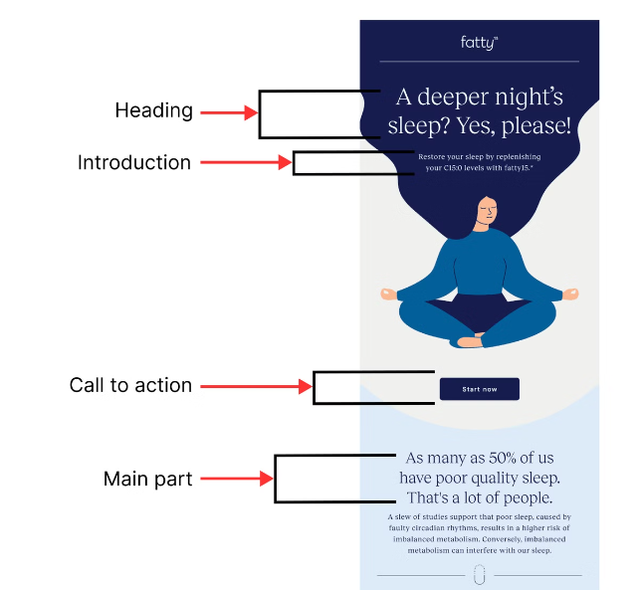
Add your concrete request or question in bold text
Body
The body is the main content of the email. It should be well-organized, clear, and concise.
Be concise
Use words that convey (authentic) positive personal emotional
Use the word “because” when asking for something
Show don’t tell
Use headings to split long content into sub-topics
Add your concrete request or question in bold text

Slide 22

Closing (Expressions for thanking)
Thank you for your help. / time / assistance / support
I really appreciate the help. / time / assistance / support you‘ve given me.
Thank you once more for your help in this matter

Slide 23
What is wrong with the following email closing: "Best regards, John Smith Director, Marketing"?
a) The closing is too informal b) The sender’s title should not be included c) There is no contact information provided d) There is no error

Slide 24
What is wrong with the following email closing: "Best regards, John Smith Director, Marketing"?
a)The closing is too informal b) The sender’s title should not be included c) There is no contact information provided d) There is no error
Answer: d) There is no error

Slide 25

Expressions with a future focus Closing
I look forward to hearing from you soon / meeting you next Tuesday.
I look forward to seeing you soon.
I‘m looking forward to your reply.
We hope that we may continue to rely on your valued custom.
We look forward to a successful working relationship in the future.
Please advise as necessary.
I would appreciate your immediate attention to this matter.

Slide 26
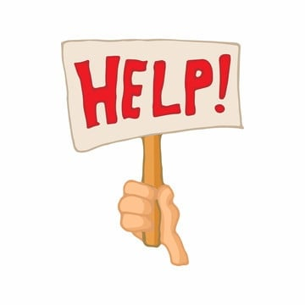
Expressions for showing them you want to help
If I can be of assistance, please do not hesitate to contact me.
If you require any further information, feel free to contact me.
If you require any further information, let me know.
Please feel free to contact me if you need any further information.
Please let me know if you have any questions.
I hope the above is useful to you.
Should you need any further information, please do not hesitate to contact me.
Please contact me if there are any problems.
Let me know if you need anything else
Drop me a line if I can do anything else for you.

Slide 27

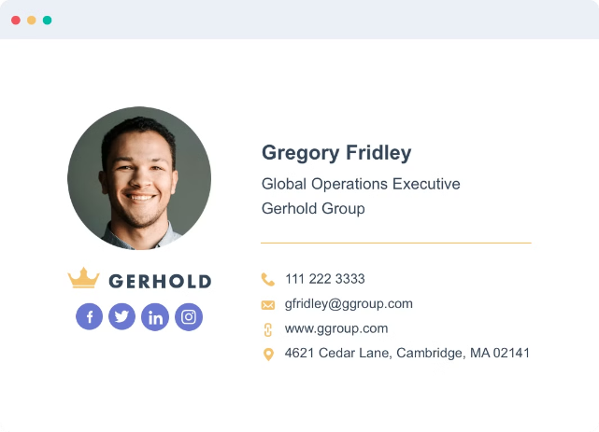
Signature
The signature provides contact information and is placed at the end of the email.
Name
Your full name
Title
Your job title, if applicable
Company
The name of your company or organization
Contact Information
Your email address, phone number, or website URL

Slide 28





Attachments
Attachments allow you to send files along with your email. Ensure the attachments are relevant and necessary.
File Types
Common attachment formats include documents, spreadsheets, presentations, images, and audio/video files.
Security
Be cautious when opening attachments from unknown senders to avoid potential malware or viruses.
Size Limits
Most email providers have limits on the size of attachments. Consider using cloud storage services for larger files.

Slide 29


